Slide 1
Team 4
WEARE APP
FINAL PROJECT DEMO

Slide 2

WEare Project Demo
WEare Project
What is WEare?
What is the project about?
Which are the main functionalities for testing?

Slide 3
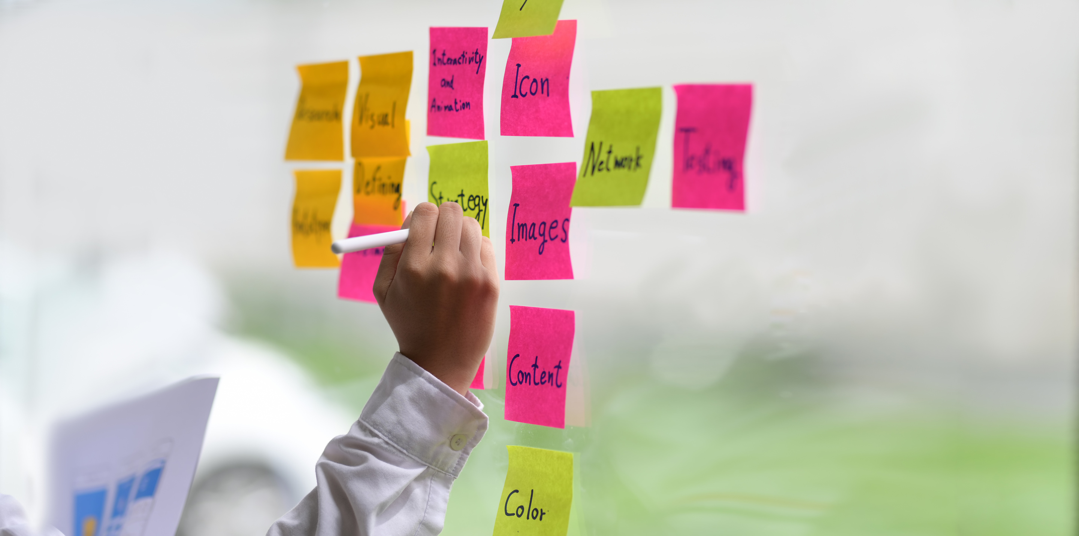

WEare Project Demo
How we started?
01
Planning
Early planning of the activities , creating Test Plan, high-level test cases
Setting Up the Projects
02
Setting up the projects in Jira (integration with X-ray), GitHub and Postman
Assigning Tasks
03
Creating a task planning document
Main challenges and how we overcame them.

Slide 4
WEare Project Demo
Hristo’s Spotlight
My overall contribution for the project

Slide 5
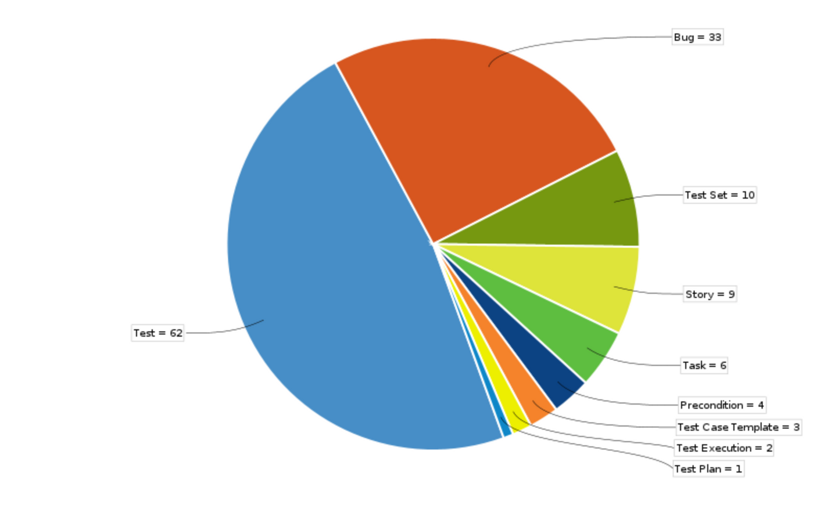
WEare Project Demo
Manual Testing
Creating templates (for test case, bug
and preconditions) in Jira
Organizing the work in Sprints according
to the Test Plan
Assigning tasks
Creating test cases
Logging bugs

Slide 6
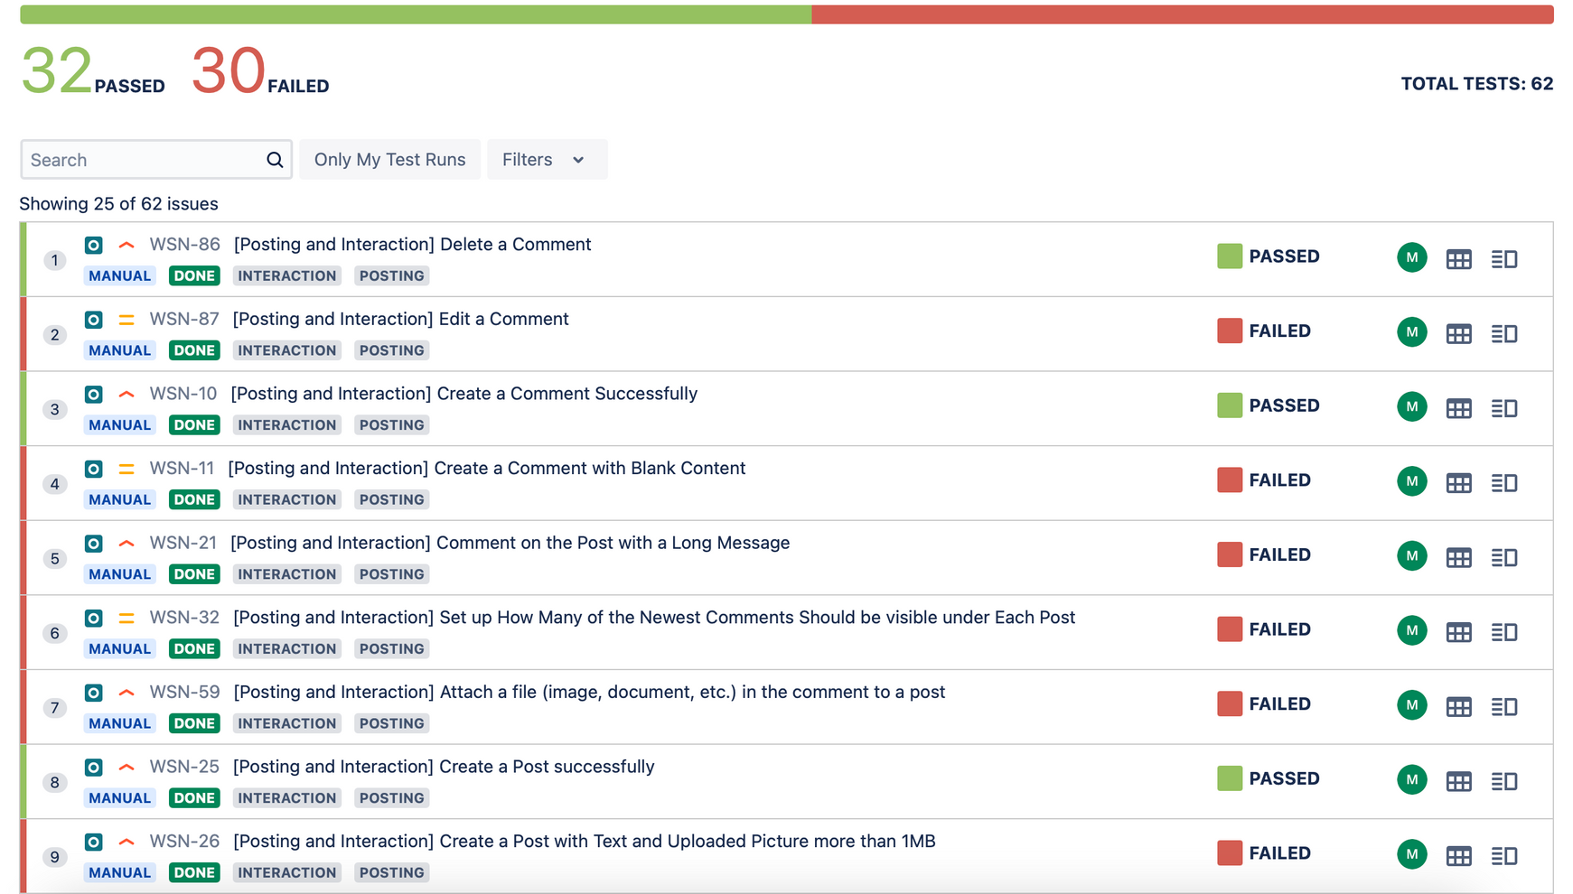
WEare Project Demo
Manual Testing

Slide 7

WEare Project Demo
Compatibility Testing
01
Testing on different browsers
Latest versions of Chrome, Mozilla Firefox and Safari
Results
02
Mobile testing
Using DevTools of Chrome browser
Results

Slide 8

WEare Project Demo
Automation Testing
API Testing
01
Creating Postman collection for the main functionalities
02
Selenium Webdriver Tests
Creating tests using Java code in IntelliJ

Slide 9
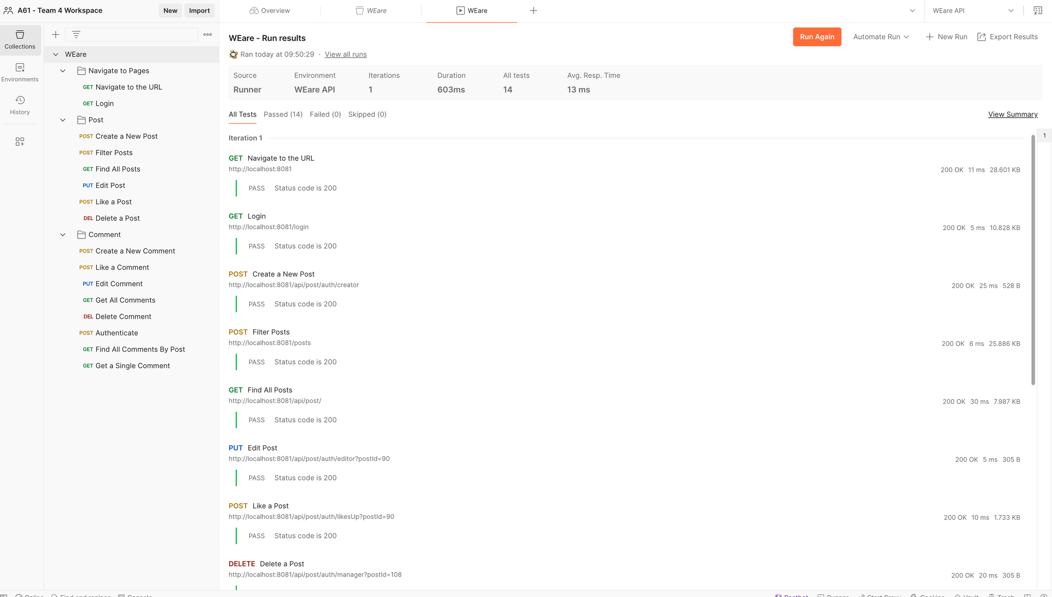
Postman
WEare Project Demo

Slide 10
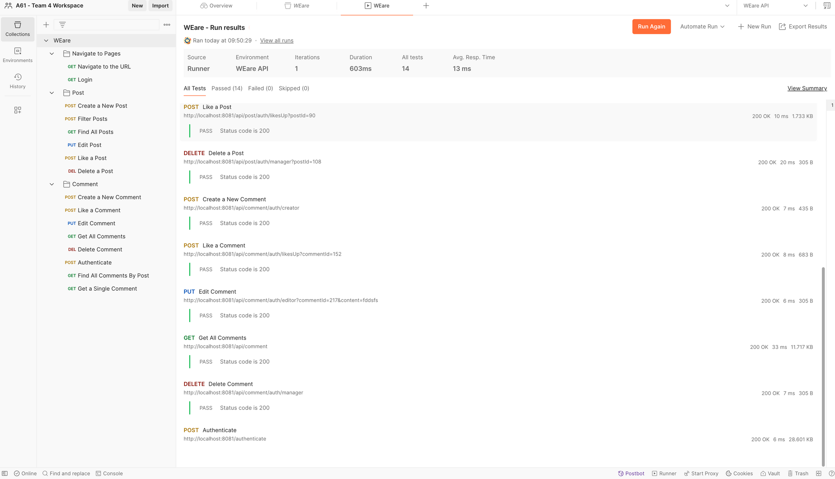
Postman
WEare Project Demo

Slide 11
WEare Project Demo
Mina’s Spotlight
My overall contribution for the project

Slide 12
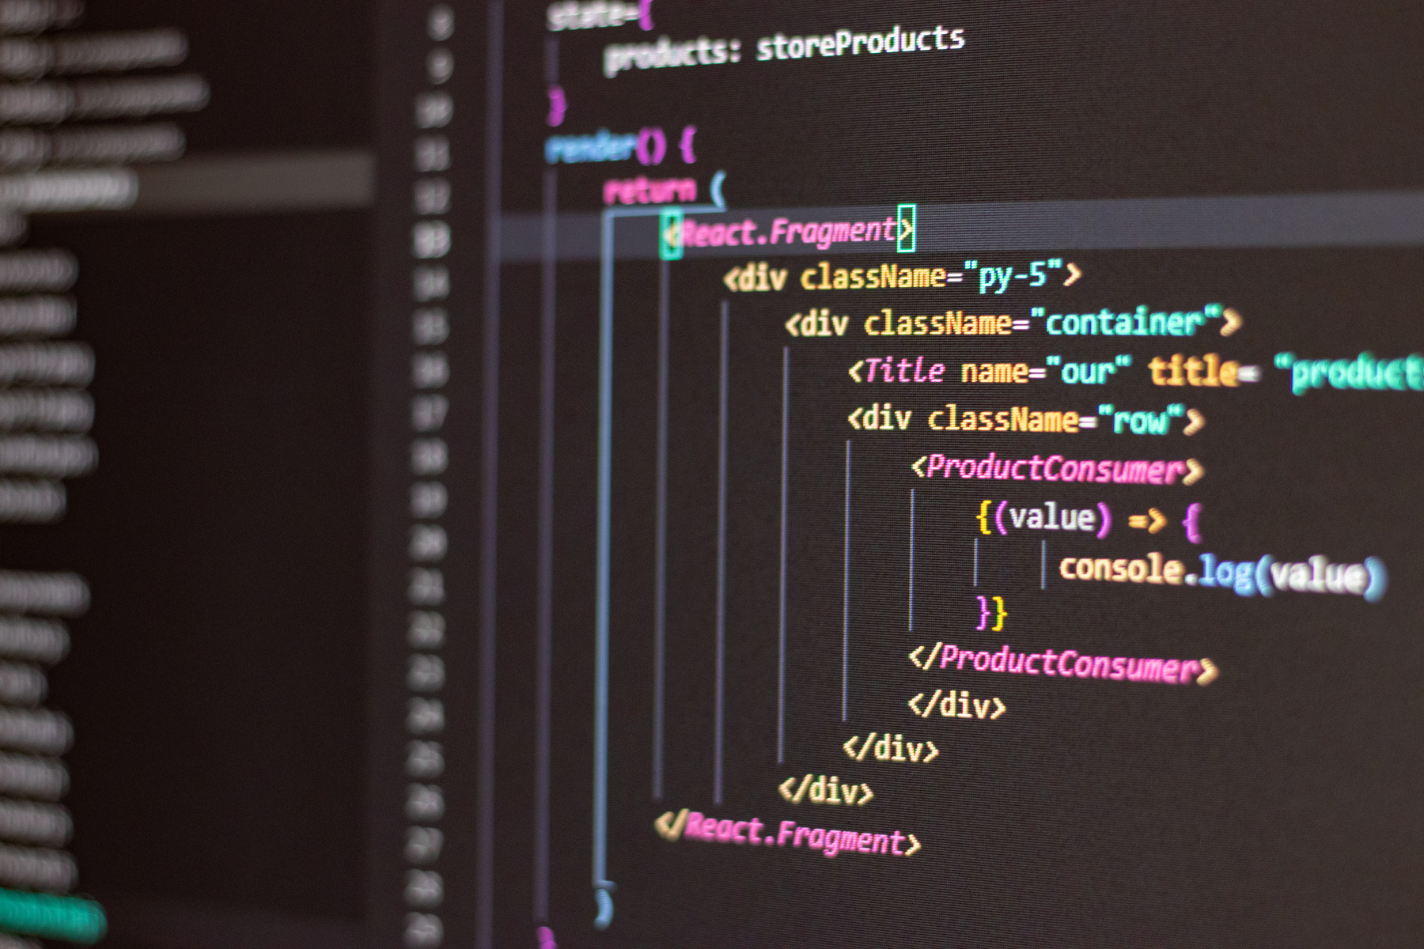
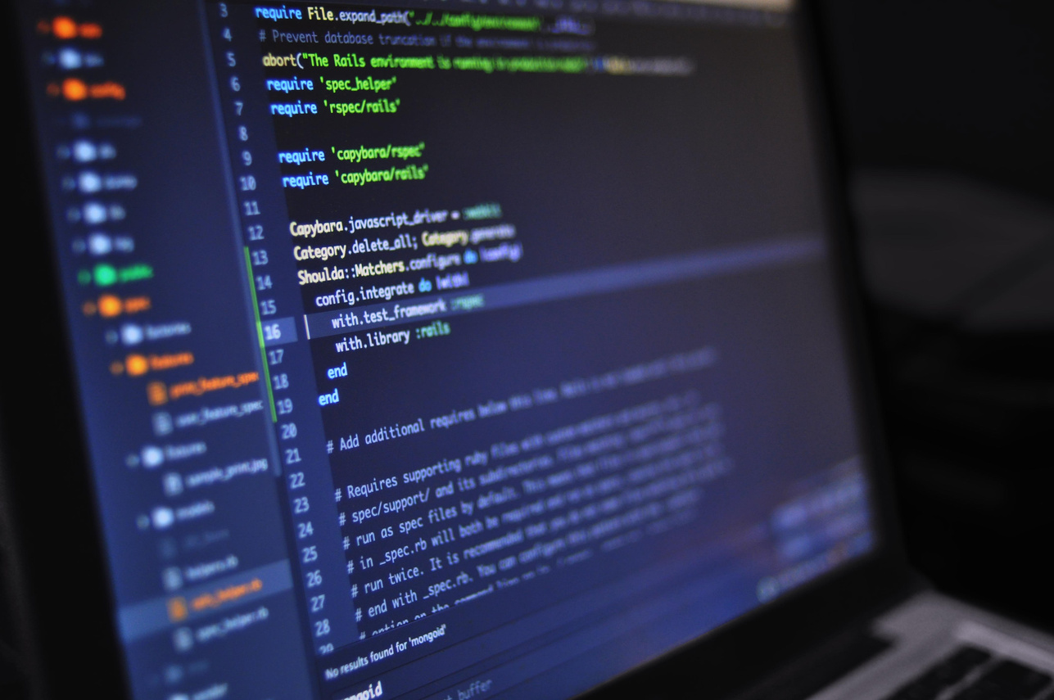
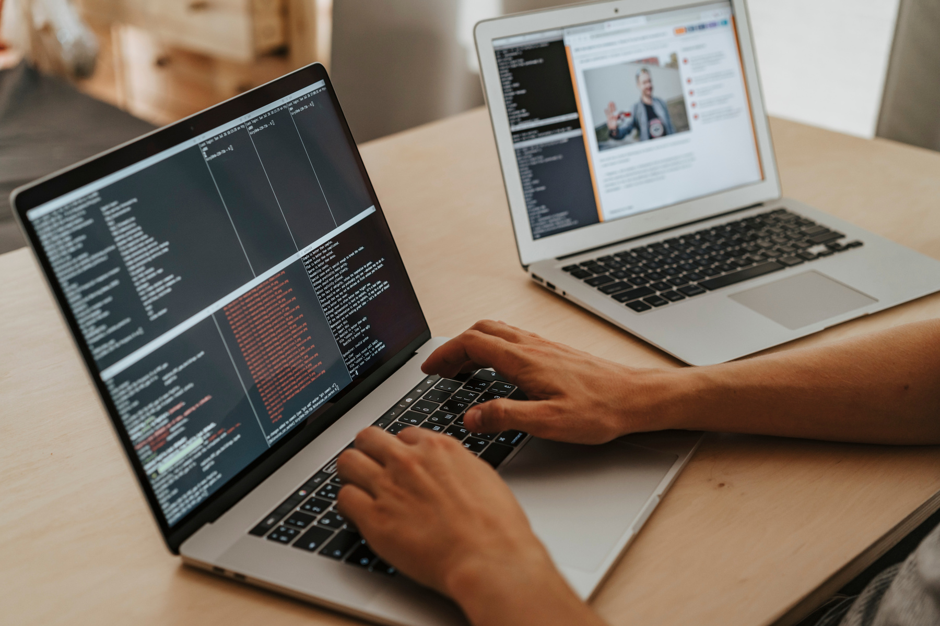
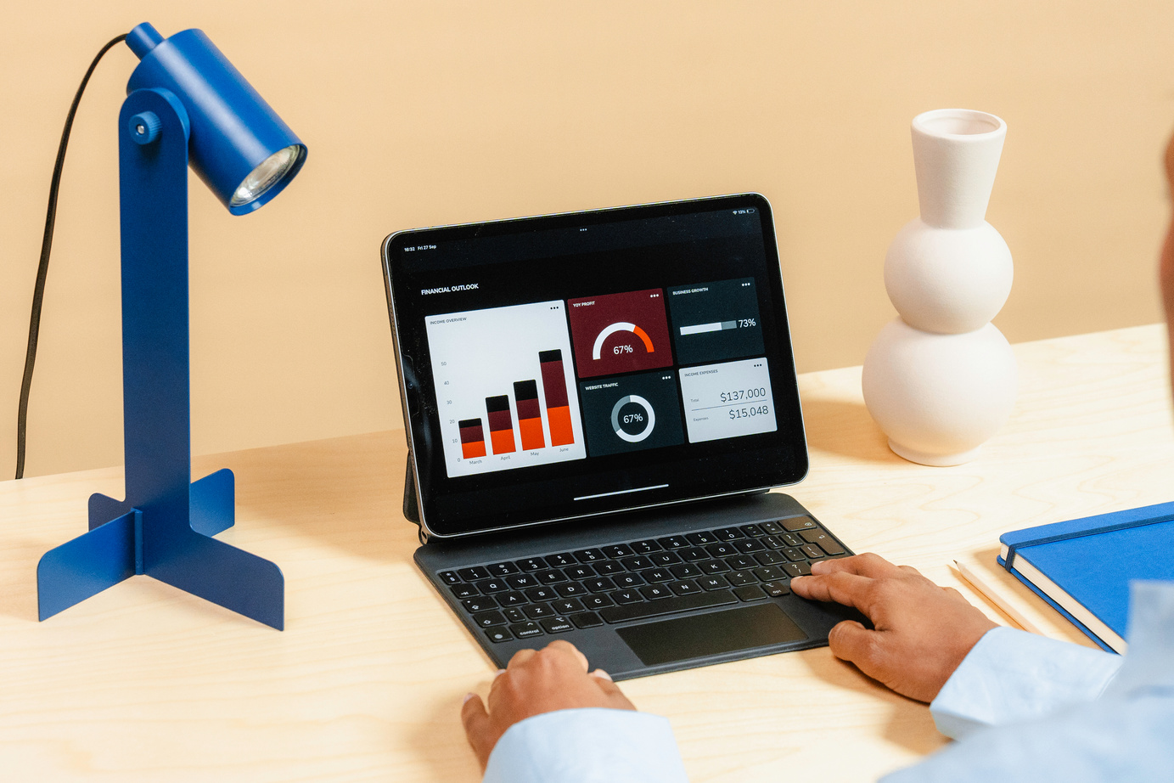
WEare Project Demo
Test Automation Framework
Our approach
How we organized the structure of the project
Writing Tests
Tests execution
01
02
03
04

Slide 13
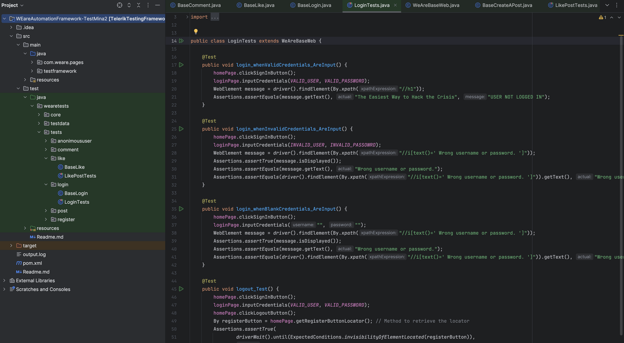
WEare Project Demo
Test Automation Framework
How we overcame them
Main difficulties

Slide 14



WEare Project Demo
Reporting

Slide 15
WEare Project Demo
Vladislav’s Spotlight
My overall contribution for the project

Slide 16
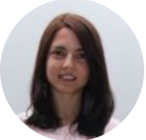
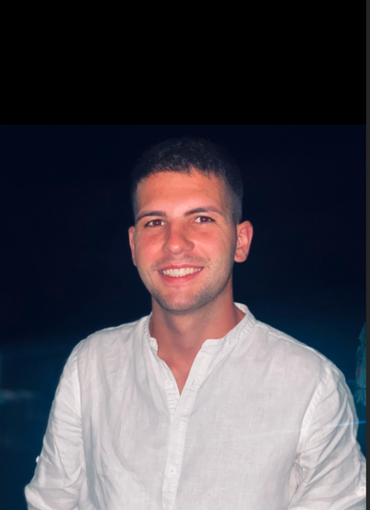
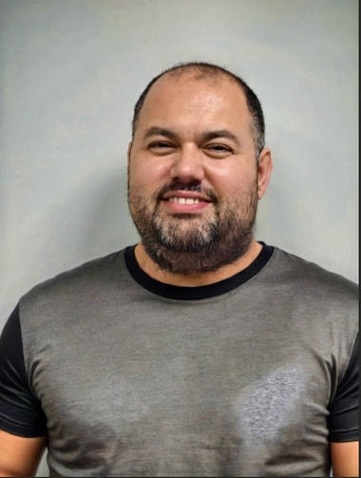
WEare Project Demo
Meet Our Team
Mina
Mladenova
Vladislav
Adamov
Hristo
Hristov
mina.mladenova.a61@learn.telerikacademy.com
vladislav.adamov.a61@learn.telerikacademy.com
hristo.hristov.a61@learn.telerikacademy.com

Slide 17
WEare Project Demo
THANK YOU

